Slide 1
Cyclistic Case Study – How do Casual Riders compare to Annual Riders?
By: Manraj Ghuman
Last Updated: July 11, 2022

Slide 2
What is Cyclistic?
Cyclistic is a Bike share company launched in 2016 with a fleto of over 5,000 bicycles
Cyclistic’s marketing strategy relied on building general awareness and appealing to broad consumer segments. One approach that helped make these things possible was the flexibility of its pricing plans: single-ride passes, full-day passes, and annual memberships.
Customers who purchase single-ride or full-day passes are referred to as casual riders. Customers who purchase annual memberships are Cyclistic members. Cyclistic’s finance analysts have concluded that annual members are much more profitable than casual riders. Although the pricing flexibility helps Cyclistic attract more customers
Notes:
In 2016, Cyclistic launched a successful bike-share offering. Since then, the program has grown to a fleet of 5,824 bicycles that are geotracked and locked into a network of 692 stations across Chicago. The bikes can be unlocked from one station and returned to any other station in the system anytime. Until now, Cyclistic’s marketing strategy relied on building general awareness and appealing to broad consumer segments. One approach that helped make these things possible was the flexibility of its pricing plans: single-ride passes, full-day passes, and annual memberships. Customers who purchase single-ride or full-day passes are referred to as casual riders. Customers who purchase annual memberships are Cyclistic members. Cyclistic’s finance analysts have concluded that annual members are much more profitable than casual riders. Although the pricing flexibility helps Cyclistic attract more customers, Moreno believes that maximizing the number of annual members will be key to future growth. Rather than creating a marketing campaign that targets all-new customers, Moreno believes there is a very good chance to convert casual riders into members. She notes that casual riders are already aware of the Cyclistic program and have chosen Cyclistic for their mobility needs. Moreno has set a clear goal: Design marketing strategies aimed at converting casual riders into annual members. In order to do that, however, the marketing analyst team needs to better understand how annual members and casual riders differ, why casual riders would buy a membership, and how digital media could affect their marketing tactics. Moreno and her team are interested in analyzing the Cyclistic historical bike trip data to identify trends.

Slide 3
Objective
Compare the behavior of casual and member riders.
Create an action plan to convert casual riders into member riders.

Slide 4
Data Process
First party data was used from January 2021 – May 2022
Data was cleaned via R
Transferred to tableau to create visualizations

Slide 5
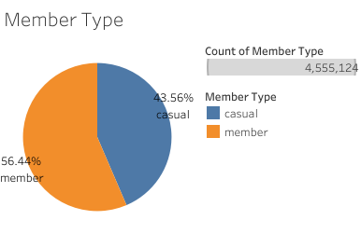
Member Share
Momentarily most riders are annual members with casual riders having more bike time

Slide 6
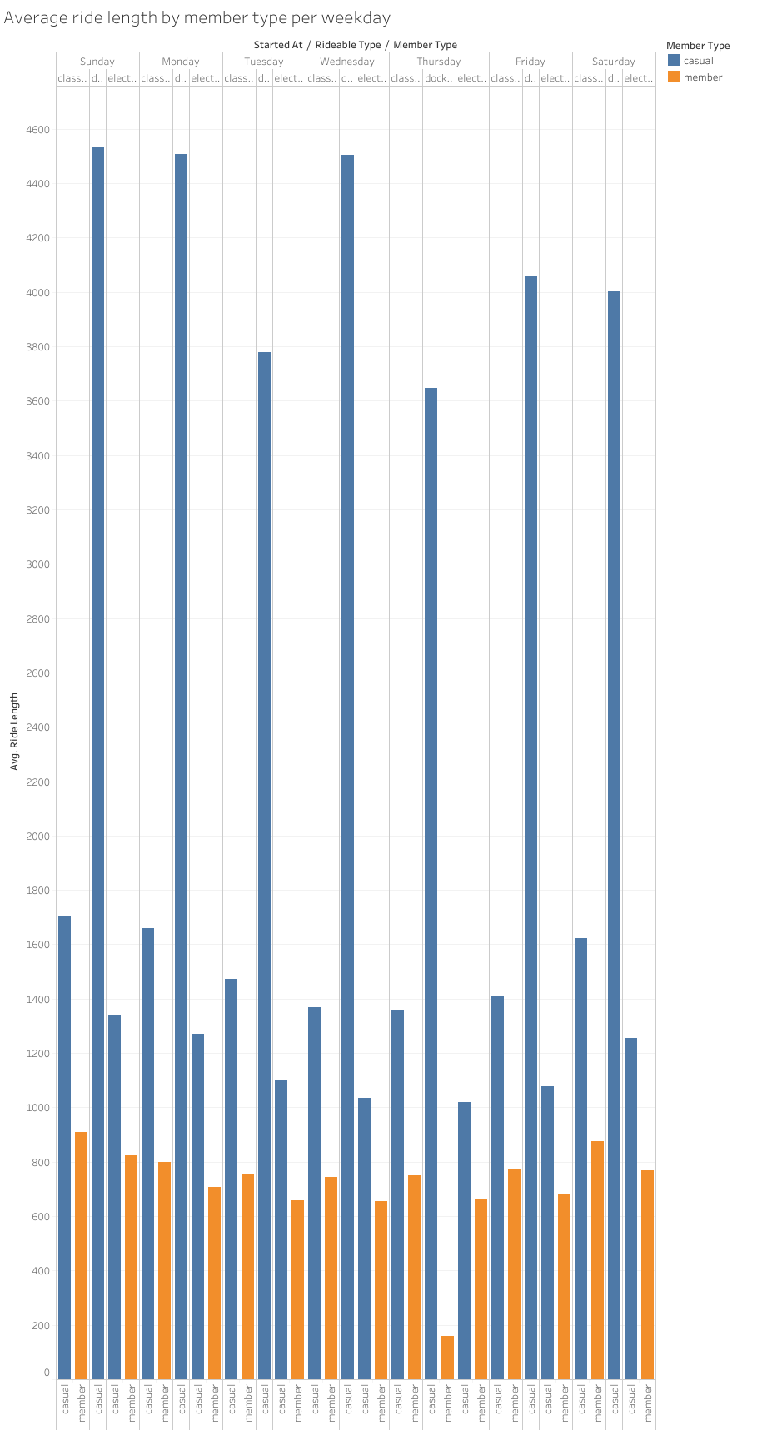

Slide 7
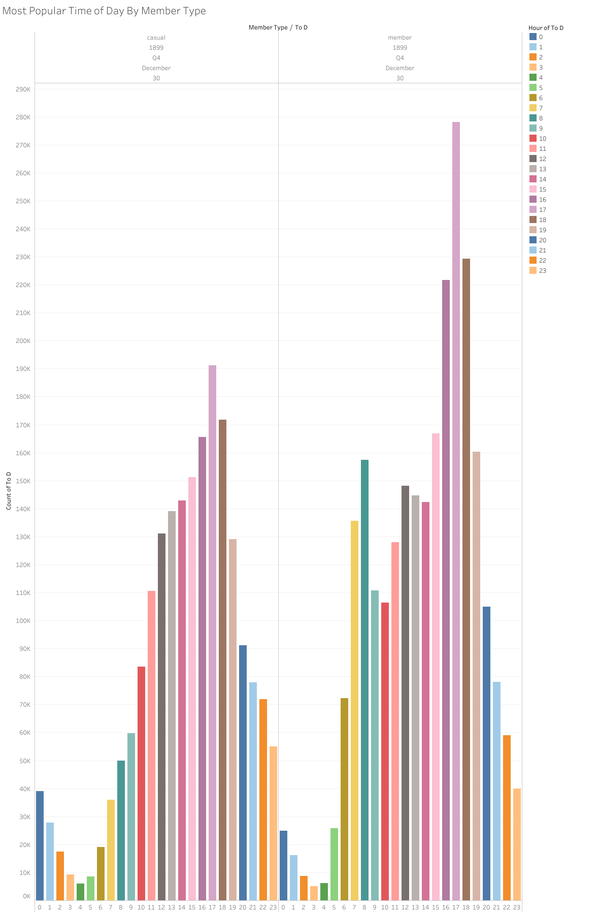
Most Popular Times by User
Most popular time for both users is between 4-7 PM

Slide 8
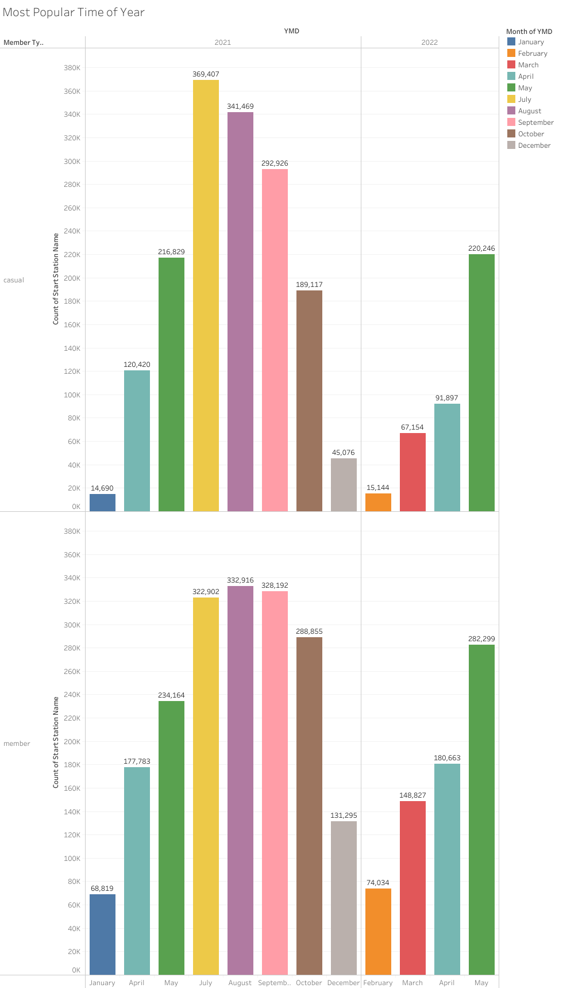
Most Popular Month By Member Type
Members: August
Casual: July

Slide 9
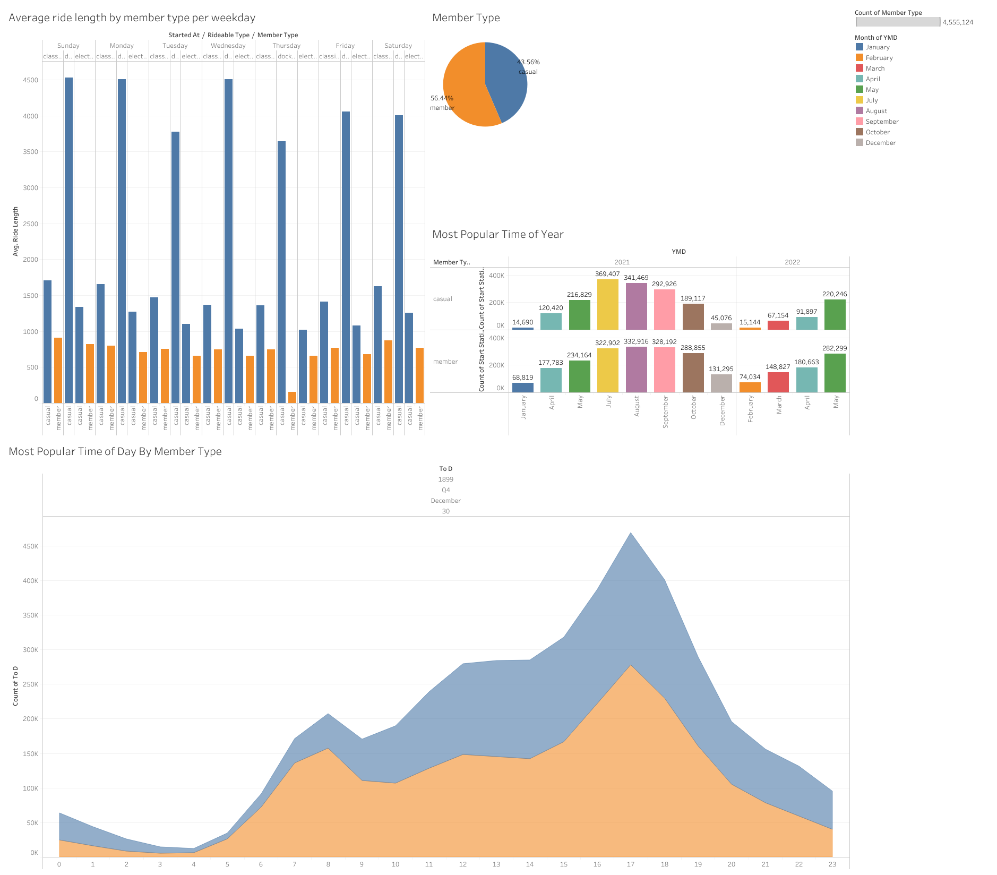

Slide 10
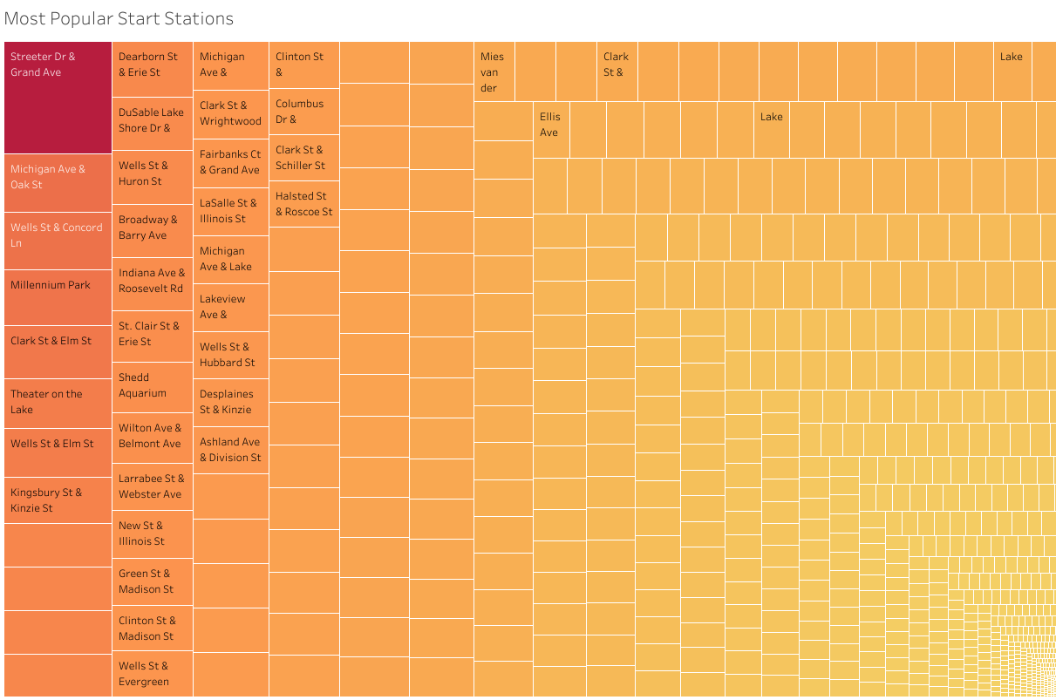
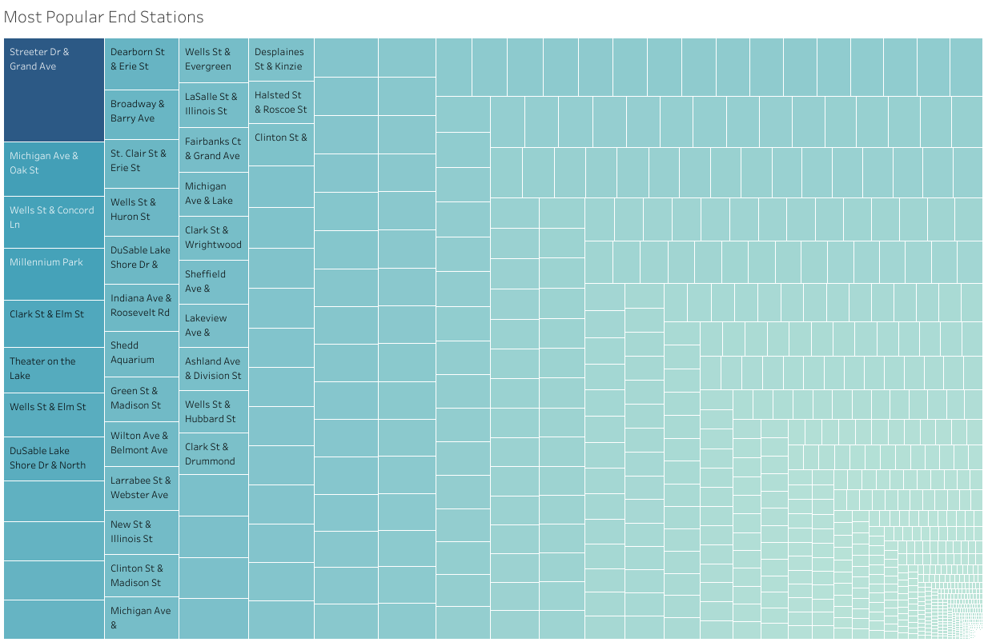
Most Popular Start and End stations
Streeter Dr & Grande Ave is the most popular start and end location

Slide 11
Key Takeaways
We see that at the moment over 56% of riders are annual members
With Streeter Dr & Grande Ave being the most popular start and end station we can increase efforts here at rider conversion
Most popular time for both users is between 4-7 PM each day
Most members ride in August with most casuals riding in July

Slide 12
Next Steps
Gather data from multiple years to se how and if COVID -19 impacted rider behavior.
Get more rider data
Such as age, sex, and home addresses to see how these relate to riders
Ask the riders why they use the bikes
Riding data to observe the track outside of start and end to see where more stations can be added
During peak times give priority to members to help create more member conversion

Slide 13

THANK YOU!
Any Questions?

